Slide 1
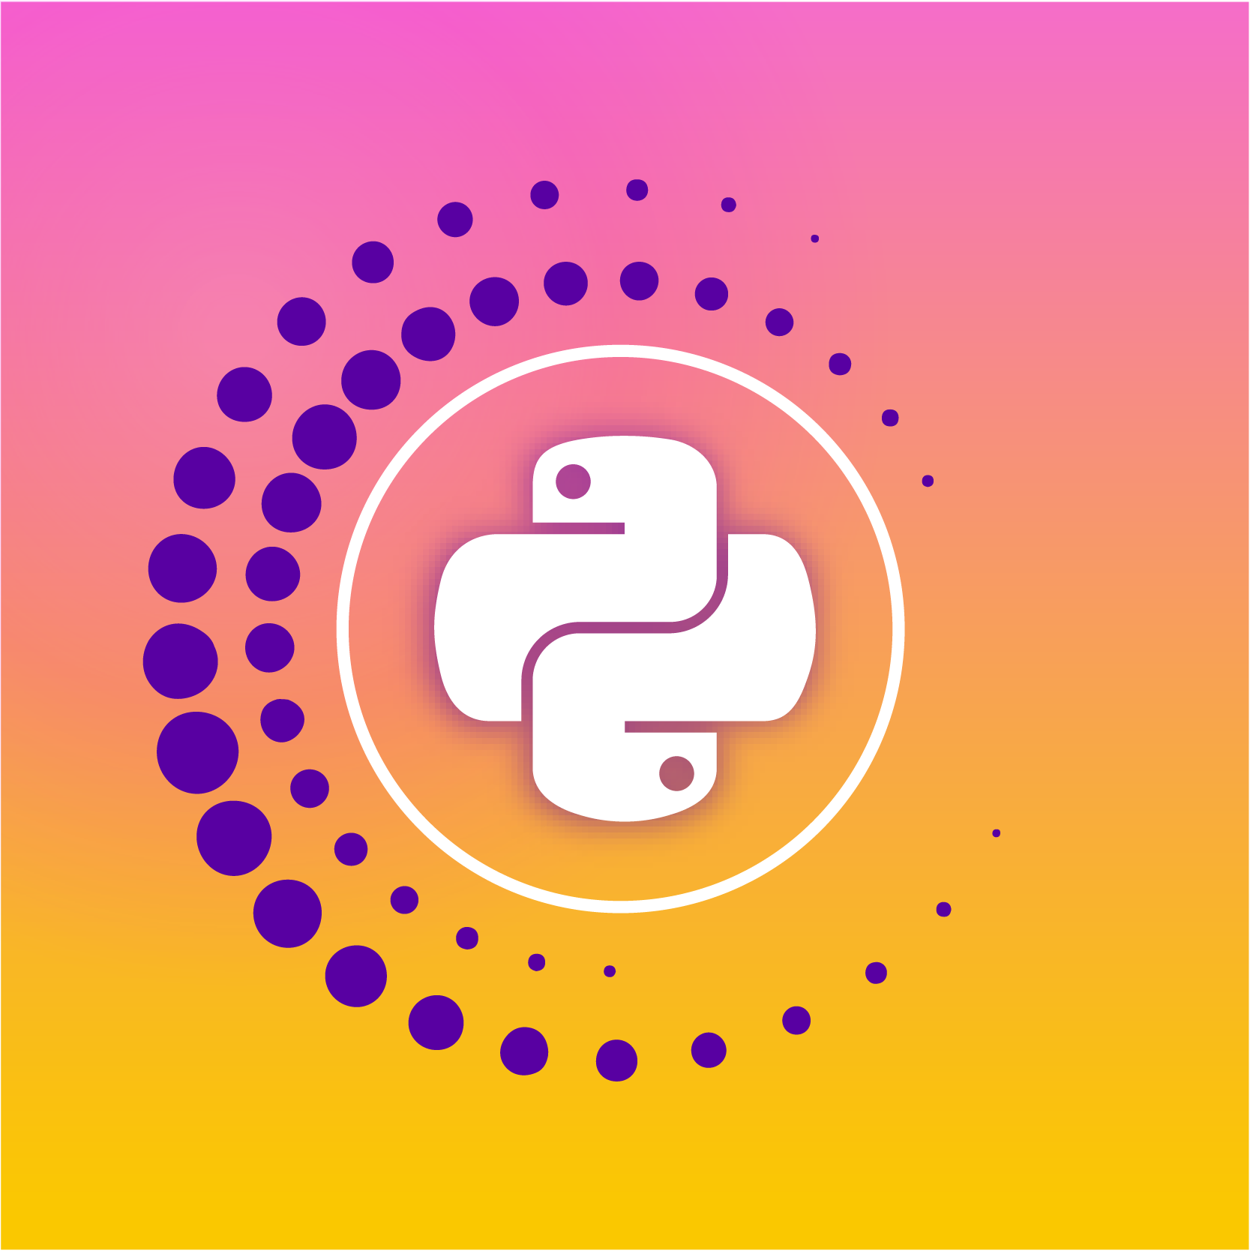

Why create a mobile app with Python?
by Leonardo Calderon Senior Developer at Endava

Slide 2

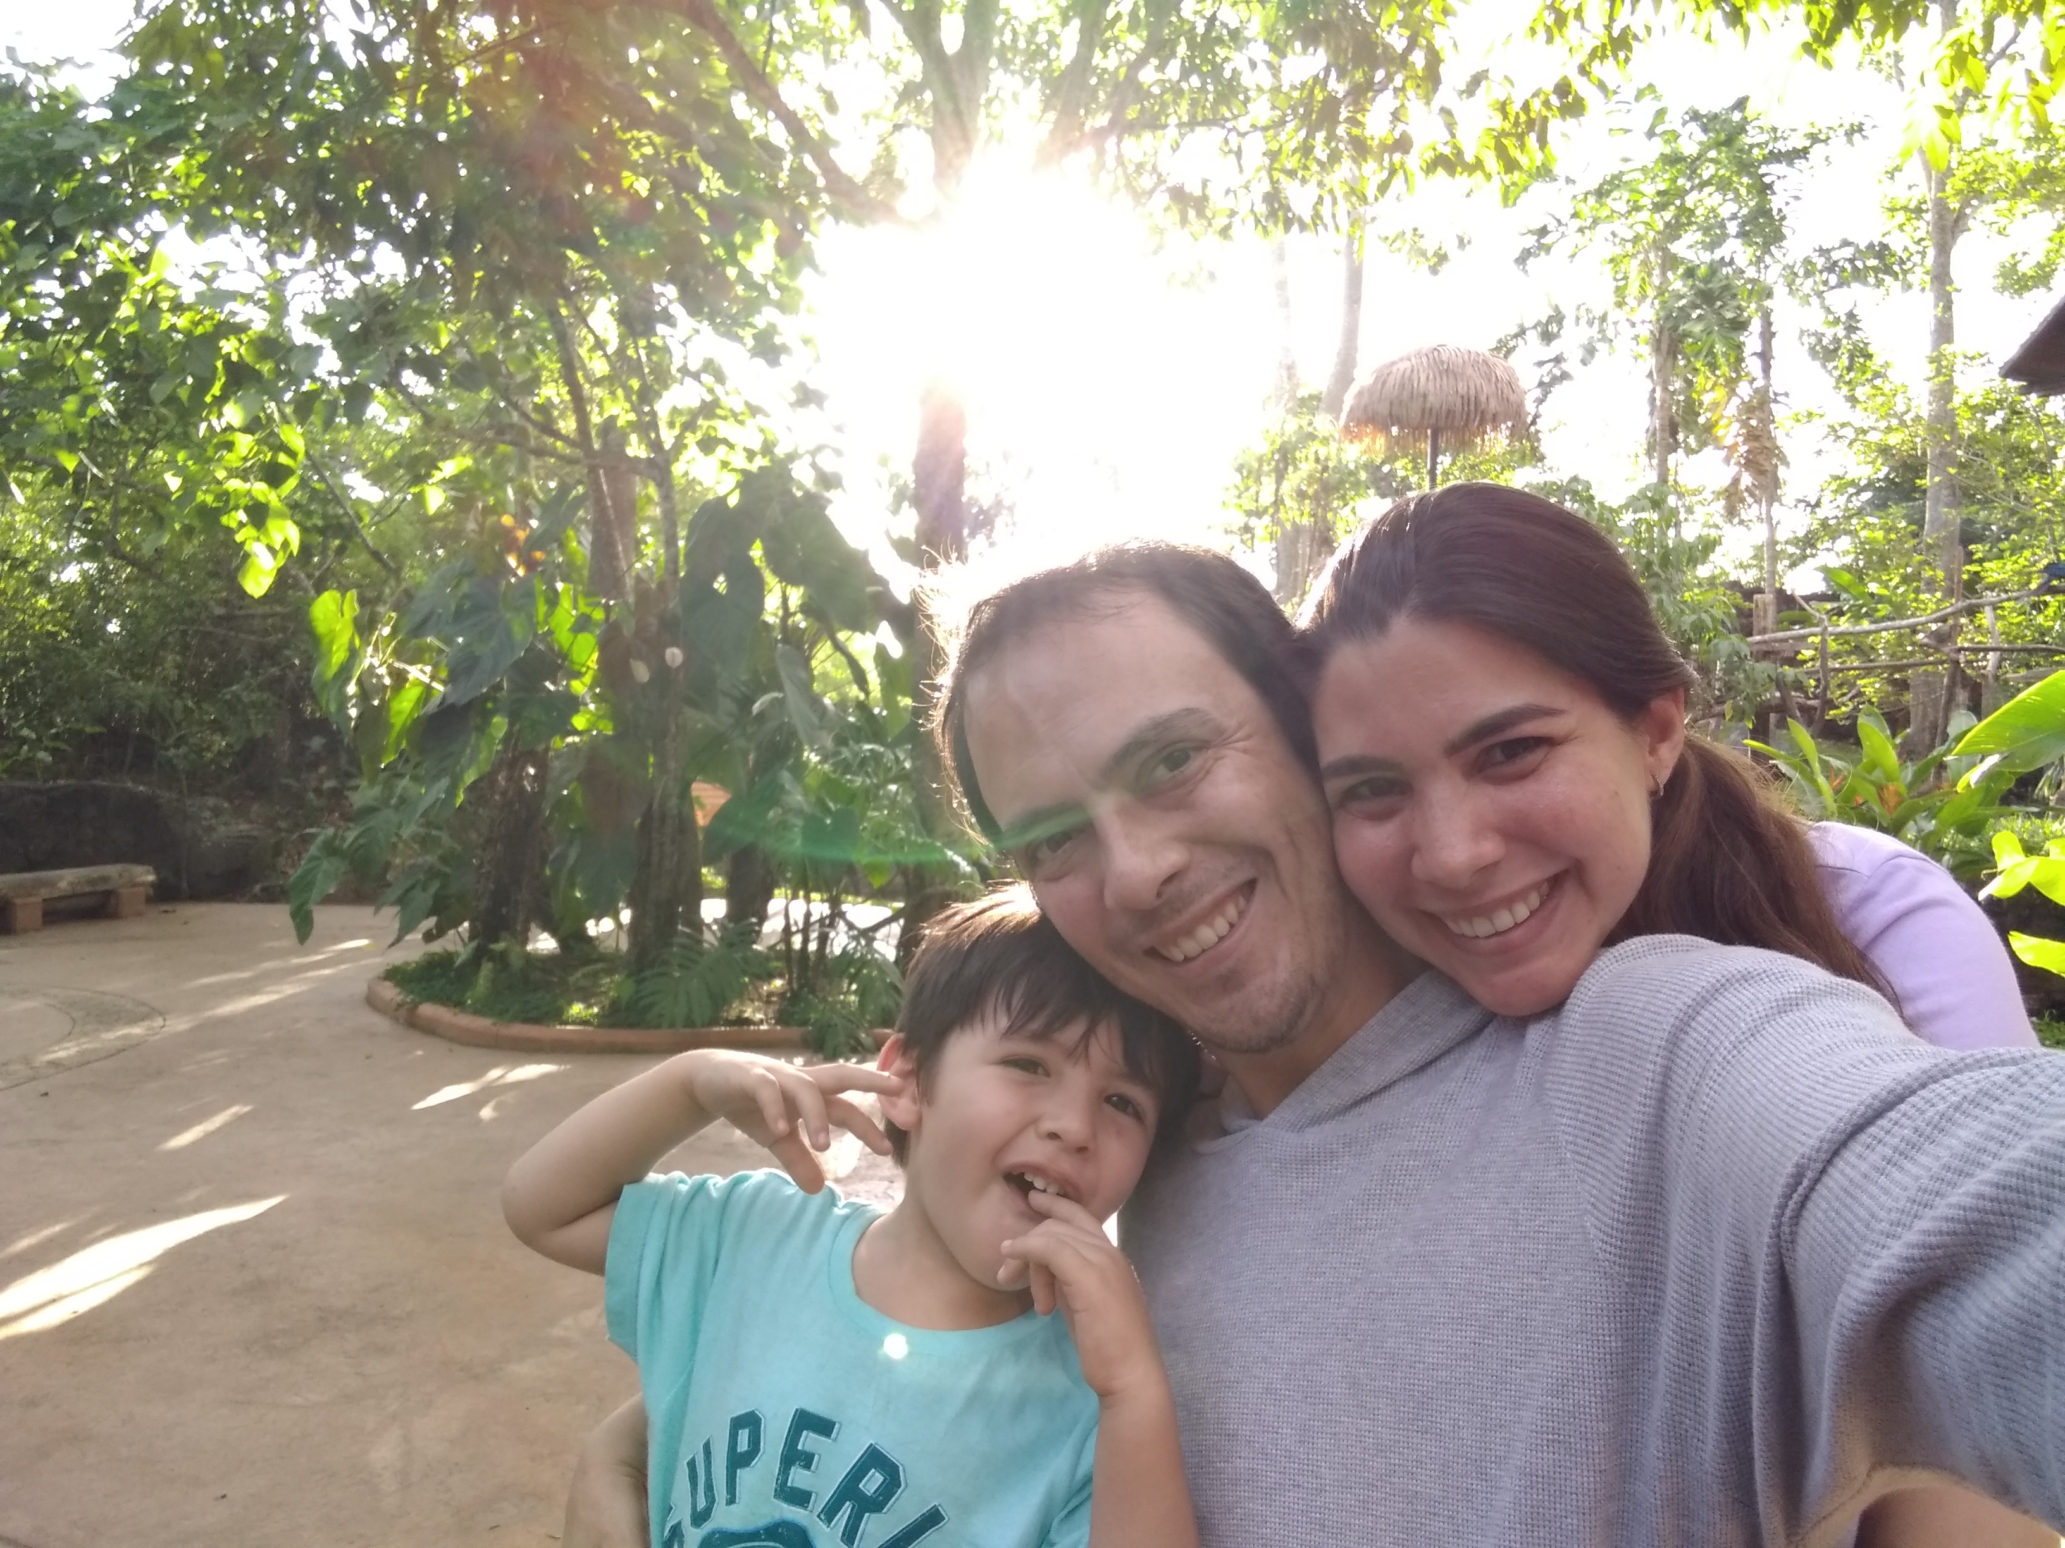
The emotional answer

Slide 3
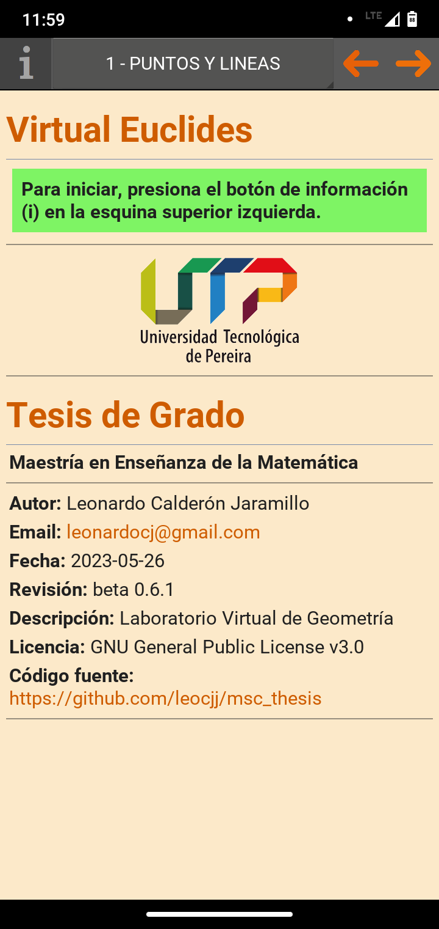
The rational answer
Because…
We can!!
Simple
Cross-platform
Native performance - by using OpenGL
Leverage Python's ecosystem
All you need is Python
Easy to share:
Go to Google Play Store
Look for Virtual Euclides (Author LeoCJJ)
Install it!!

Slide 4
About me
I’m a husband, a father, an engineer, a software developer…
… that’s why I studied a Master Degree In Math and this is my thesis story
… I love Math, Physics, and solving problems, you could say I love getting into trouble…

Slide 5
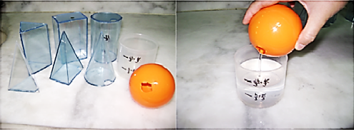

My initial goal
A laboratory for teaching Geometry,
because I was a STEAM professor
Duru, A. (2010). The experimental teaching in some of topics geometry. Educational Research and Reviews, 5(10), 584-592. Retrieved from https://academicjournals.org/journal/ERR/article-abstract/43C57274193

Slide 6

Then…
2020
World lockdown
I lost my job as a Professor
I closed down my consulting entrepreneurship
But also, great things happened
My son was born
And I was hired by Endava
Image created with You.com – YouImagine – AI Image Generator. Model: Stable Diffusion 2.1.

Slide 7
The Why is more powerful than the How
So, I started again…

Slide 8
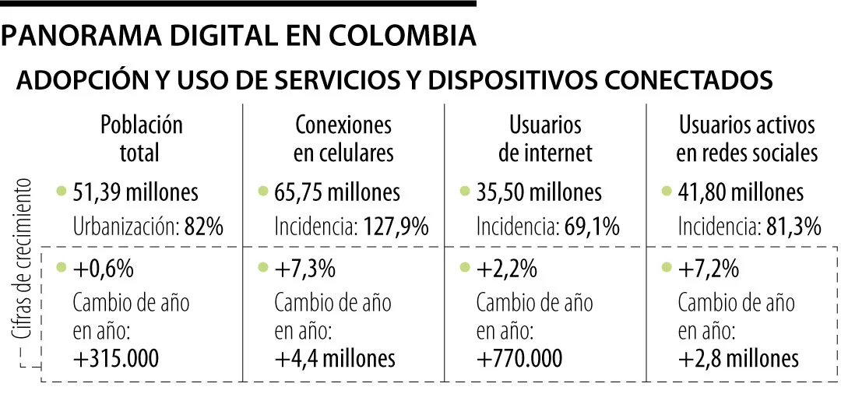
But where should I start
What could I do in the new –remote- world?
An app
What kind of app?
Desktop? → Not everyone has one
Web? → Need a device and an ISP
Mobile? → Everyone has a cell phone!!
128% of cell phones
69% of internet access
Gaviria, N. (16 de Julio de 2022). Retrieved from Editorial La República: https://www.larepublica.co/economia/los-celulares-superan-el-total-de-la-poblacion-por-cada-colombiano-hay-1-2-moviles-3403559

Slide 9
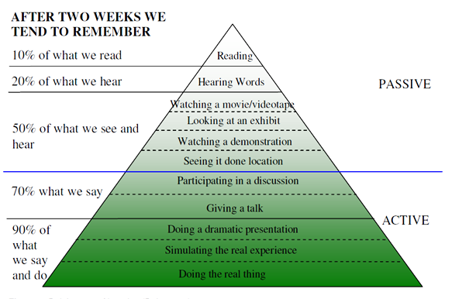

From ‘doing’ to ‘simulating’
This gave me x1000 times more access to students
But I’m a Python Developer,
not a Mobile Developer
Dale, E. (1969). Audio-visual methods in teaching (3 ed.). New York: Holt, Rinehart and Winston.

Slide 10

Exploring an endless list
Some Technologies / Languages explored
Java
Python
Swift
Javascript
Kotlin
React native
Ionic
PhoneGap
Xamarin
Sencha
Flutter
Inmune. (14 de Octubre de 2021). Lenguajes de programación para móvil. Retrieved from Immune Technology Institute: https://immune.institute/lenguajes-de-programacion-para-movil/
InnovaAge. (2022). Retrieved from: https://www.innovaportal.com/innovaportal/v/696/1/innova.front/ apps-hibridas-vs-nativas-vs-generadas-que-decision-tomar
Sakovich, N. (2022). Cross-Platform Mobile Development: Five Best Frameworks. Retrieved from: SaM Solutions: https://www.sam-solutions.com/blog/cross-platform-mobile-development/

Slide 11
Why not Python?
Turtle | docs.python.org/3/library/turtle.html
BeeWare | beeware.org
Kivy | kivy.org
QPython | www.qpython.com
Termux | play.google.com/store/apps
Matplotlib | matplotlib.org
Blender | www.blender.org
Panda3D | www.panda3d.org
Bokeh | bokeh.org
OpenCV | opencv.org
Sandbox | www.sandbox.game
Adabala, P. (26 de Agosto de 2020). Create and run Python apps on your Android phone. Retrieved from Opensource: https://opensource.com/article/20/8/python-android-mobile
Farooq, U. (14 de Junio de 2018). Tools to run Python on Android. Retrieved from Medium: https://medium.com/@umerfarooq_26378/tools-to-run-python-on-android-9060663972b4
Gui Programming. (5 de Agosto de 2022). The Python Wiki. Retrieved from Python Software Foundation: https://wiki.python.org/moin/GuiProgramming
Python on Android. (30 de Agosto de 2022). The Python Wiki. Retrieved from Python Software Foundation: https://wiki.python.org/moin/Android

Slide 12
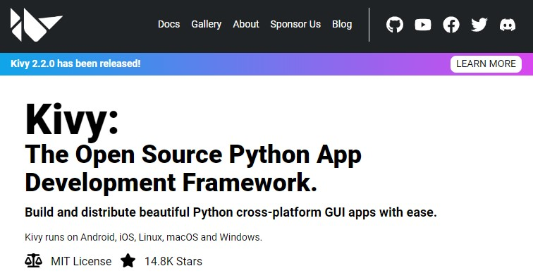
And I chose…

Slide 13
Finally
An open-source app
github.com/leocjj/msc_thesis
High availability
play.google.com/store/apps/
details?id=co.edu.utp.virtualeuclides
Lightweight
less that 20 Mb
Content
2 chapters - 11 sections 40 pages - 29 interactive graphics!!

Slide 14
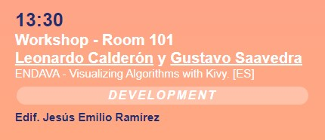
Want to learn more?
An easy environment setup option
conda create -n kivy python=3.10
conda activate kivy
conda install kivy -c conda-forge

Slide 15
Main app
View
main.py
root.kv
from rootwidget import RootWidget
class Virtual_EuclidesApp(App):
def build(self):
self.root = Builder.load_file("pages/root.kv")
self.next_screen("intro.kv")
def next_screen(self, screen):
self.root.container.clear_widgets()
screen = Builder.load_file(screen)
self.root.container.add_widget(screen)
Virtual_EuclidesApp().run()
#:kivy 2.1.0
#:set line_color (0.988, 0.914, 0.789, 1)
RootWidget:
# import container
container: container
# main window
BoxLayout:
orientation: 'vertical’
# top menu
BoxLayout:
IconButton:
on_press: app.next_screen(2.1.2')
# create a container for dynamic content
BoxLayout:
id: container

Slide 16
Controller
rootwidget.py
from math import asin, atan, pi
class RootWidget(BoxLayout):
"" Receive widget, create controller for kv file
Add actions to be called from a kv file. """
l_1 = ListProperty([0, 0, 0, 0])
container = ObjectProperty(None)
def cap2_sec1_pag3(self):
"""Control sliders events""“
Clock.schedule_interval(self.update_points, 0.01)
y = self.slider_y.value
max_length = max(self.height, self.width)
# Horizontal fixed line bottom
self.l_1 = [
self.width / 3,
self.height * 3 / 4,
self.width * 2 / 3,
self.height * (3 + y) / 4
]
View
root.kv
#:kivy 2.1.0
#:set line_color (0.988, 0.914, 0.789, 1)
RootWidget:
# import container
container: container
# main window
BoxLayout:
orientation: 'vertical’
# top menu
BoxLayout:
IconButton:
on_press: app.next_screen(2.1.2')
# create a container for dynamic content
BoxLayout:
id: container

Slide 17
Controller
root.kv
rootwidget.py
# top menu
BoxLayout:
...
# create container to show content
BoxLayout:
id: container
from math import asin, atan, pi
class RootWidget(BoxLayout):
"" Receive widget, create controller for kv file
Add actions to be called from a kv file. """
l_1 = ListProperty([0, 0, 0, 0])
container = ObjectProperty(None)
def cap2_sec1_pag2(self):
"""Control sliders events""“
Clock.schedule_interval(self.update_points, 0.01)
y = self.slider_y.value
max_length = max(self.height, self.width)
# Horizontal fixed line bottom
self.l_1 = [
self.width / 3,
self.height * 3 / 4,
self.width * 2 / 3,
self.height * (3 + y) / 4
]
2.1.2.kv
View
#:kivy 2.1.0
#:set line_width 1.1
RootWidget:
slider_y: y # define variable
Slider:
id: y
on_value: root.cap2_sec1_pag2()
canvas:
Color:
rgba: line_color
Line:
points: root.l_1
width: line_width

Slide 18
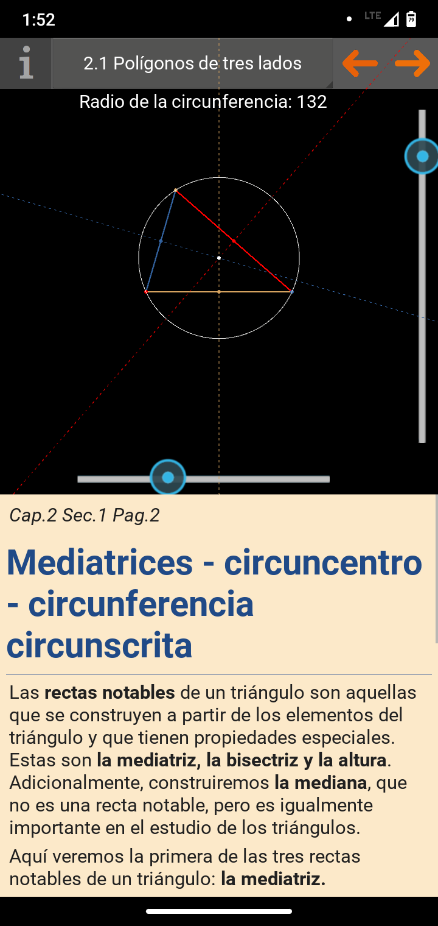
# top menu
BoxLayout:
RootWidget:
slider_y: y
Slider:
id: y
on_value: root.cap2_sec1_pag2()
canvas:
Color:
rgba: line_color
Line:
points: root.l_1
RstDocument:
source: “2.1.2.rst"
# for content
BoxLayout:
id: container
root.kv
2.1.2.kv
2.1.2.rst ReStructuredText

Slide 19
Deployment
buildozer.spec
$ pip install buildozer
$ pip install --upgrade Cython==0.29.19
$ buildozer init # Create buildozer.spec
$ nano buildozer.spec
# Install Android Studio and configure credentials
# Plug in your android device by USB cable and run:
$ buildozer android debug deploy run
# Creates APK file to be installed directly
$ buildozer android debug
# Creates AAB file to be uploaded to Google Play Store
$ buildozer android release
[app]
title = Virtual Euclides
package.name = virtualeuclides
package.domain = co.edu.utp
requirements = python3,kivy,docutils
presplash.filename = ./images/app_presplash.png
icon.filename = ./images/app_icon.png
version = 0.6.1
osx.kivy_version = 2.1.0

Slide 20
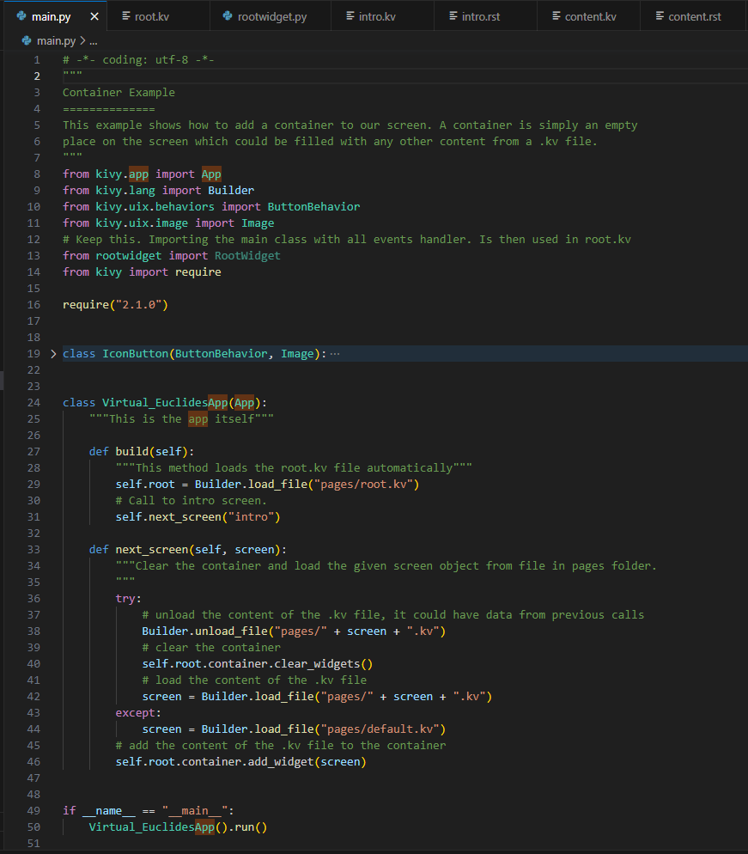
Demo time
VS Code
kv_101

Slide 21
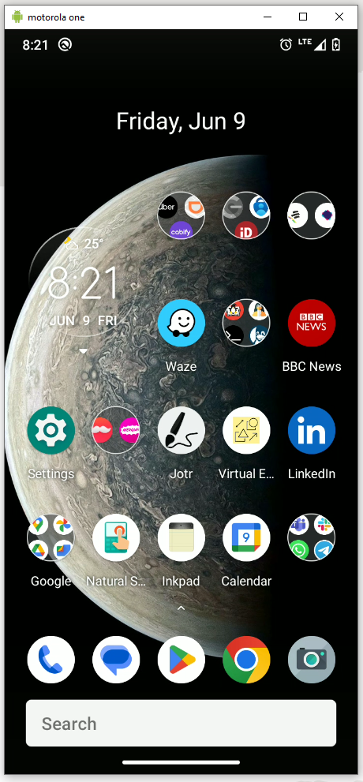
Demo using scrcpy
Connect USB
cmd
> scrcpy
github.com/Genymobile/scrcpy

Slide 22

Thank you!!
Leonardo Calderon Senior Developer at Endava
leonardo.calderon@endava.com
github.com/leocjj
leonardocj@gmail.com
linkedin.com/in/leonardocj/

